Slide 1

WELCOME
COHORT 5
7th Sept – 3rd Dec 2026
Suite 6-6-7, Level 6, Menara MAA

Slide 2



Languages for Building Web Application
Build a web page structure
Add stylings to web page
Add dynamic behavior/interactivity
to web page

Slide 3
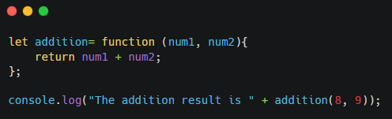

Function Expressions (Anonymous)
An anonymous function in JavaScript is a function that doesn't have a specific name.
Notes:
An anonymous function is a function that is not declared with a specific name. Instead, it is often defined as an expression and assigned to a variable. This allows the function to be called later using the variable name.
let addition = function (num1, num2){ ... };: Here, an anonymous function function (num1, num2){ return num1 + num2; } is created and assigned to the variable addition.
return num1 + num2;: This is the body of the function, which simply returns the sum of the two input parameters.
console.log("The addition result is " + addition(8, 9));: This line calls the anonymous function (via the addition variable) with arguments 8 and 9, and then prints the result to the console. The output will be "The addition result is 17".

Slide 4
Function Closure
A closure is when a function remembers the variables from the place where it was created, even if it's run somewhere else later.
Data Privacy: Creating private variables that can't be accessed directly from outside

Slide 5
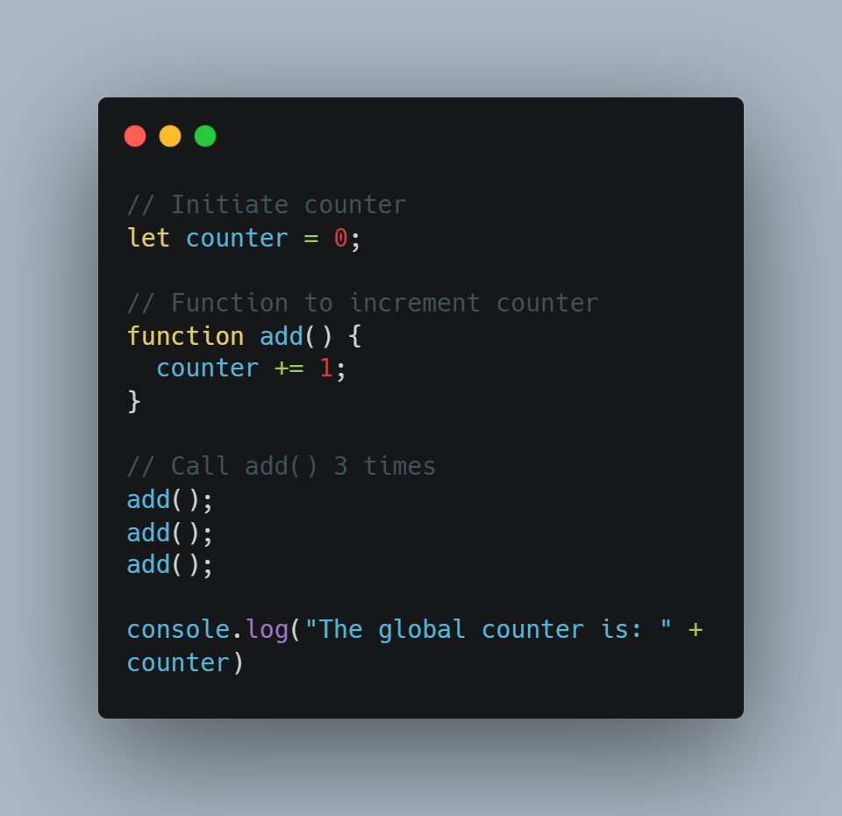

Function Closure
The main problem with this code is any code on the page can change the counter, without calling add().

Slide 6
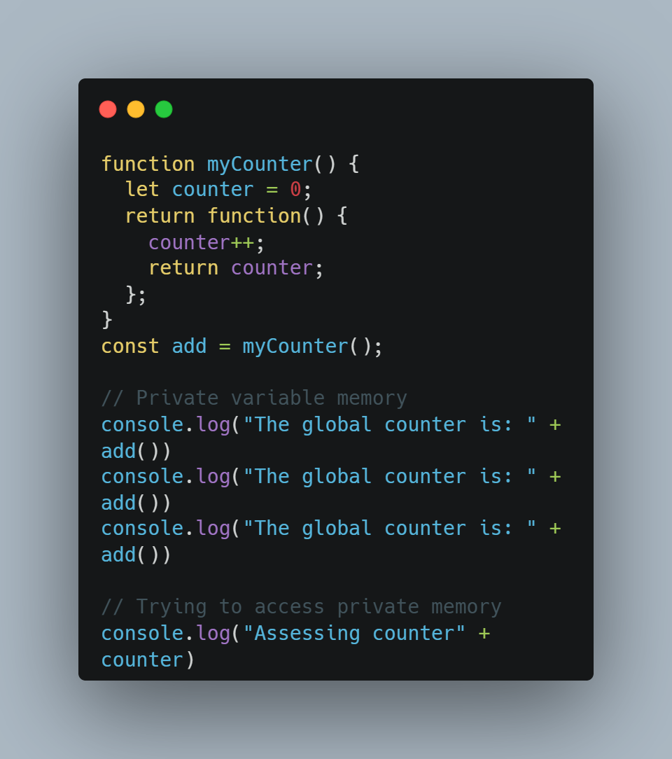
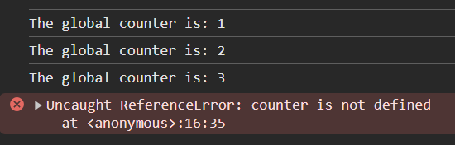
Function Closure
your variable can only be accessed via myCounter function

Slide 7
Function - Higher Order
A Higher-Order Function (HOF) is simply a function that operates on other functions.
A function qualifies as an HOF if it does at least one of the following:
Takes one or more functions as arguments.
Returns a function as its result.

Slide 8
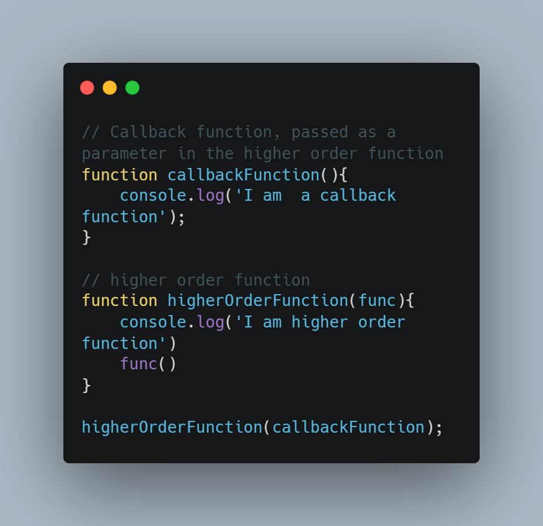

Function - Higher Order
Credit to Sobit Prasad - https://www.freecodecamp.org/news/higher-order-functions-in-javascript-explained/

Slide 9
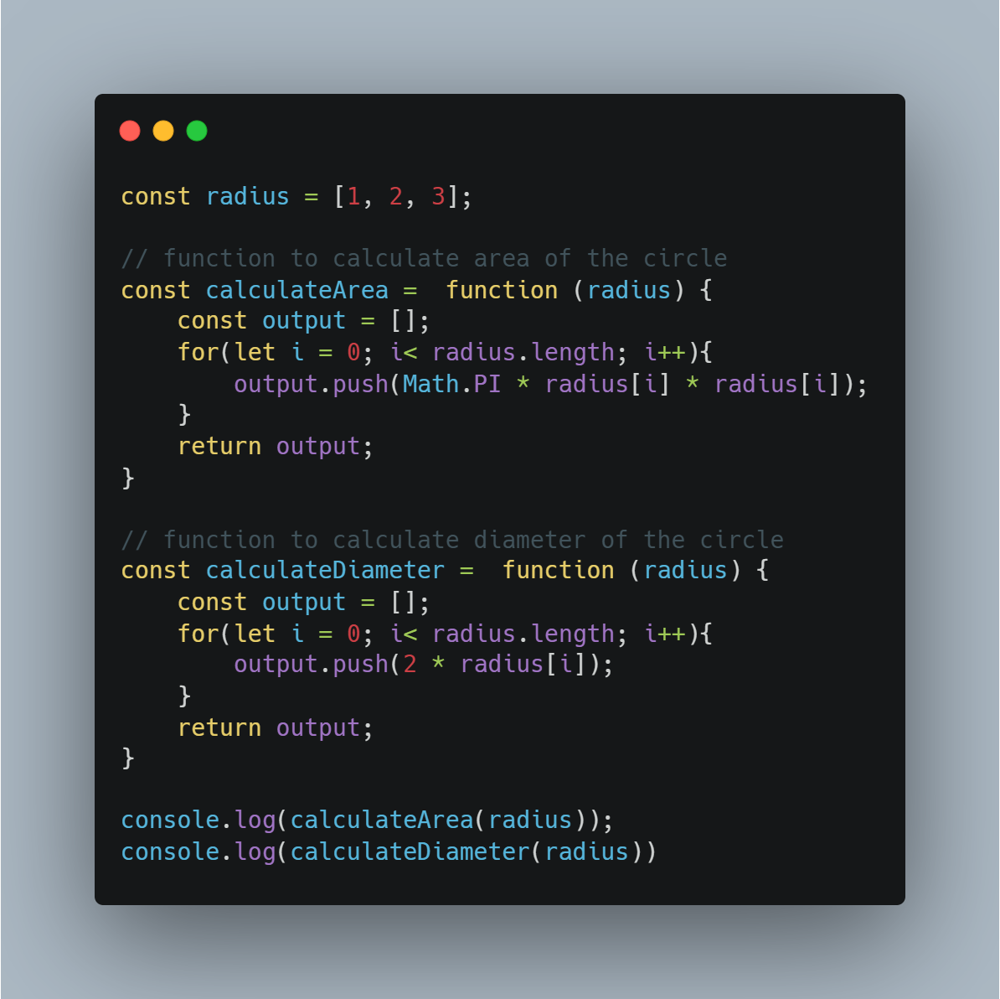
Function - Higher Order
Lets create a function to calculate area and diameter based on given radius
Credit to Sobit Prasad - https://www.freecodecamp.org/news/higher-order-functions-in-javascript-explained/

Slide 10
Function - Higher Order
Repeating pattern of function
Credit to Sobit Prasad - https://www.freecodecamp.org/news/higher-order-functions-in-javascript-explained/

Slide 11
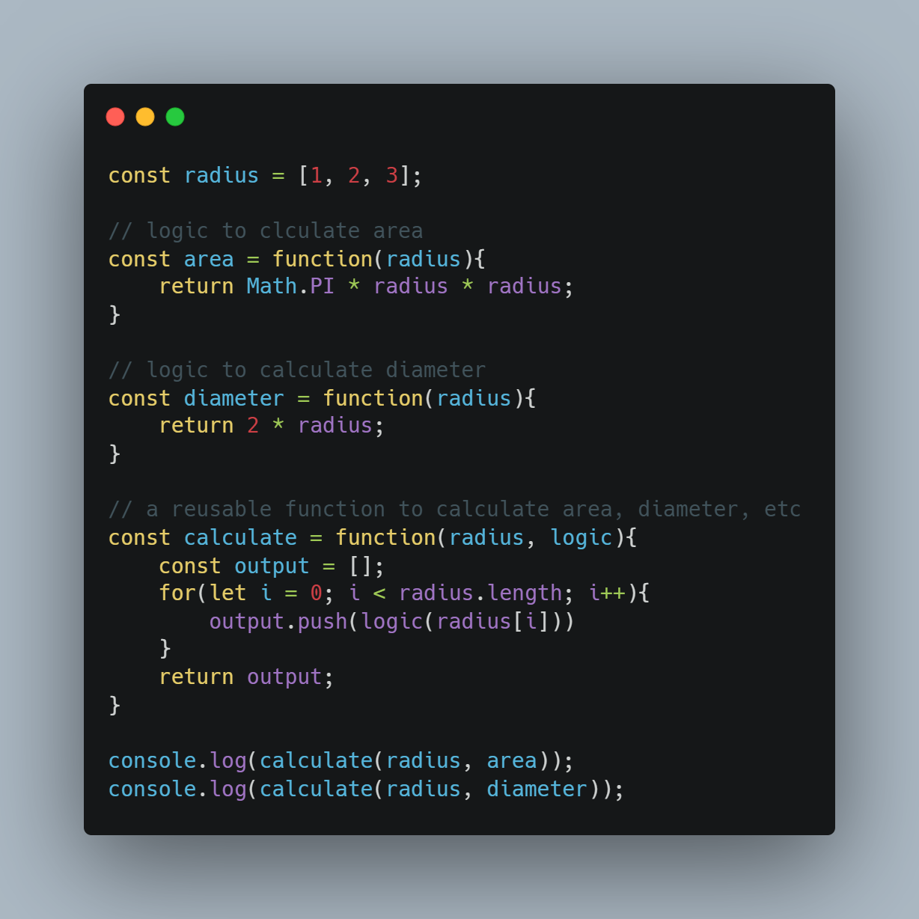
Function - Higher Order
Repeating pattern in a single function
Credit to Sobit Prasad - https://www.freecodecamp.org/news/higher-order-functions-in-javascript-explained/

Slide 12
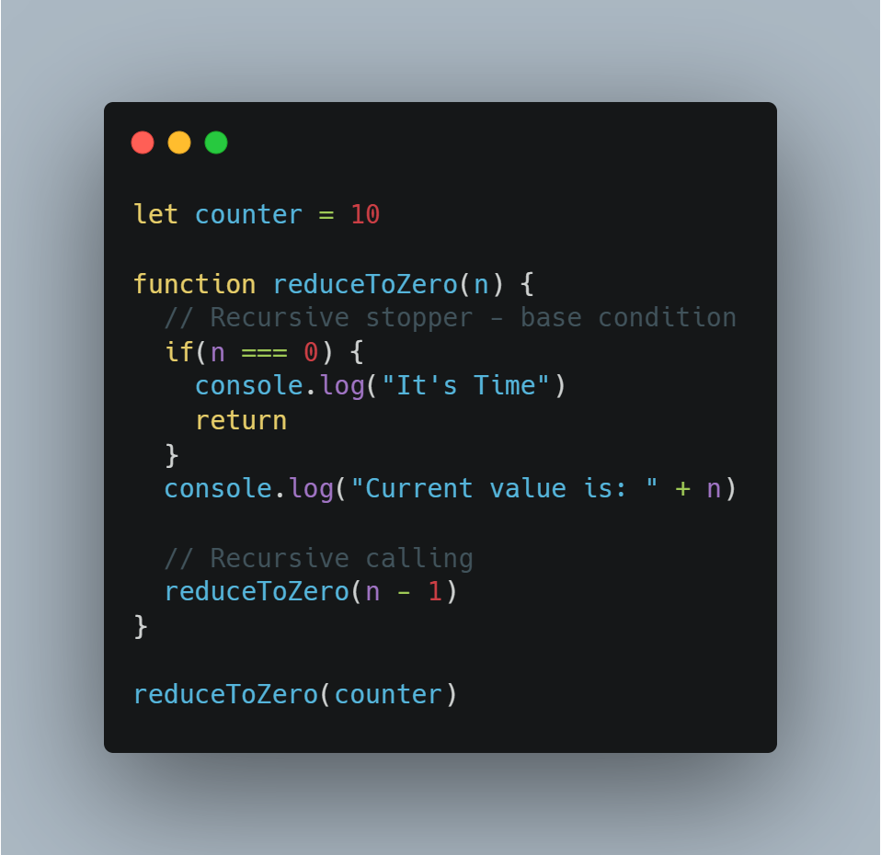
Programming Paradigms - Recursive
Recursion is a process where a function calls itself to solve a problem.
Alternative to “for loop”

Slide 13
Programming Paradigms - Object Oriented Programming (OOP)
Object-Oriented Programming is a programming paradigm based on the concept of "objects"
Why?
  Organization: Groups related data and functionality together, making code easier to manage.
  Reusability: Objects and classes can be reused in different parts of the application or in other projects.
  Maintainability: Changes to one part of the system are less likely to break other parts (if designed well).
  Modularity: Breaks down complex problems into smaller, self-contained units.

Slide 14
Programming Paradigms - Object Oriented Programming (OOP)
Key Concepts in OOP
  Objects: These are the fundamental building blocks of OOP. Each object has its own state (data) and behavior (methods).
  Classes: A class is a blueprint for creating objects. It defines the structure and behavior that all objects of that type will have.

Slide 15
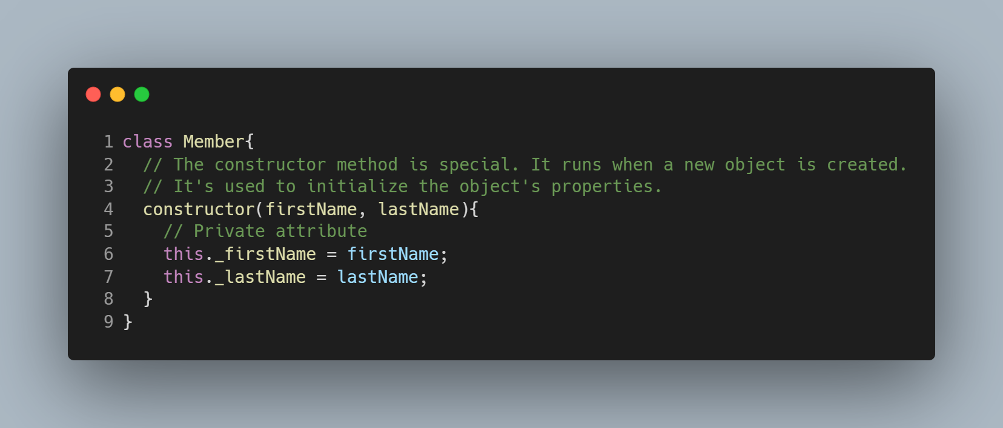
Programming Paradigms - Object Oriented Programming (OOP)
Create a Class constructor

Slide 16
Programming Paradigms - Object Oriented Programming (OOP)
this._firstName = firstName;
this._lastName = lastName;
To reference attributes from code inside the body of any method of the class we use dot syntax with the this keyword.
The attributes started with underscore to denote them as private
Code outside the class shouldn’t directly use private attributes

Slide 17
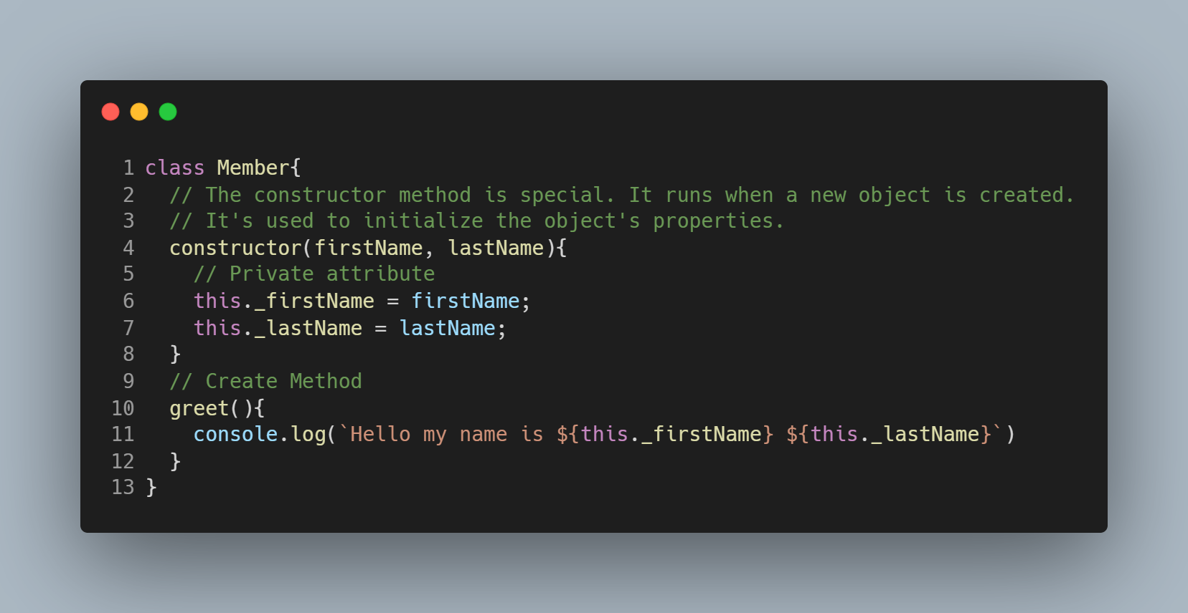
Programming Paradigms - Object Oriented Programming (OOP)
Create a Method in a Class

Slide 18
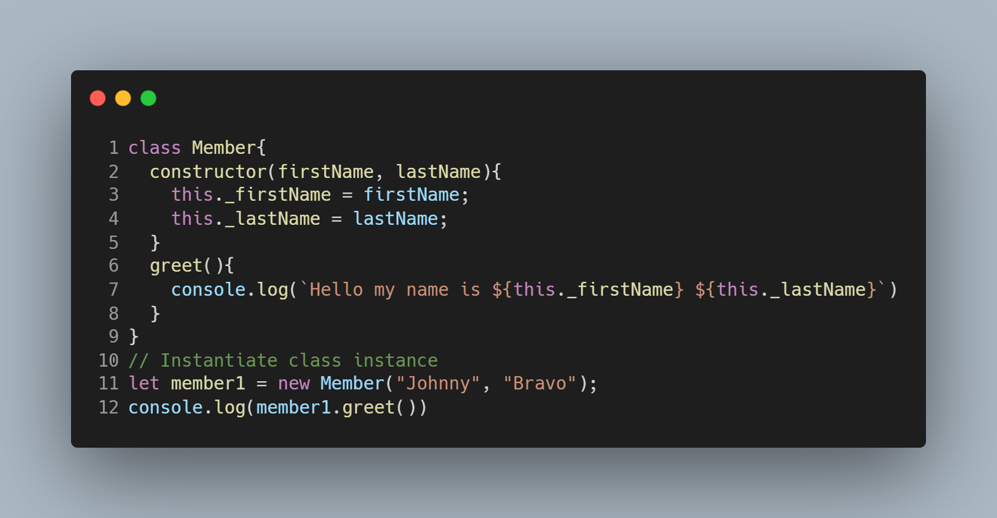
Programming Paradigms - Object Oriented Programming (OOP)
Create a Method in a Class
Instantiation of a class

Slide 19
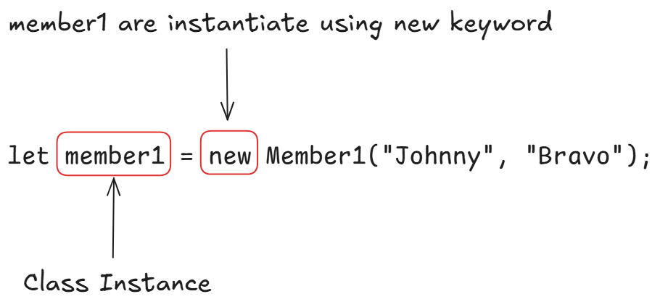
Programming Paradigms - Object Oriented Programming (OOP)
The instantiation of a class will result in a call to the class’ constructor method to initialize its private attribute

Slide 20
Programming Paradigms - Object Oriented Programming (OOP)
We like attributes to be considered private but be indirectly accessible via public methods.
Accessors (getter): public methods that get the value of private attribute
Mutators (setter): public methods that set the value of private attributes in a controlled way

Slide 21
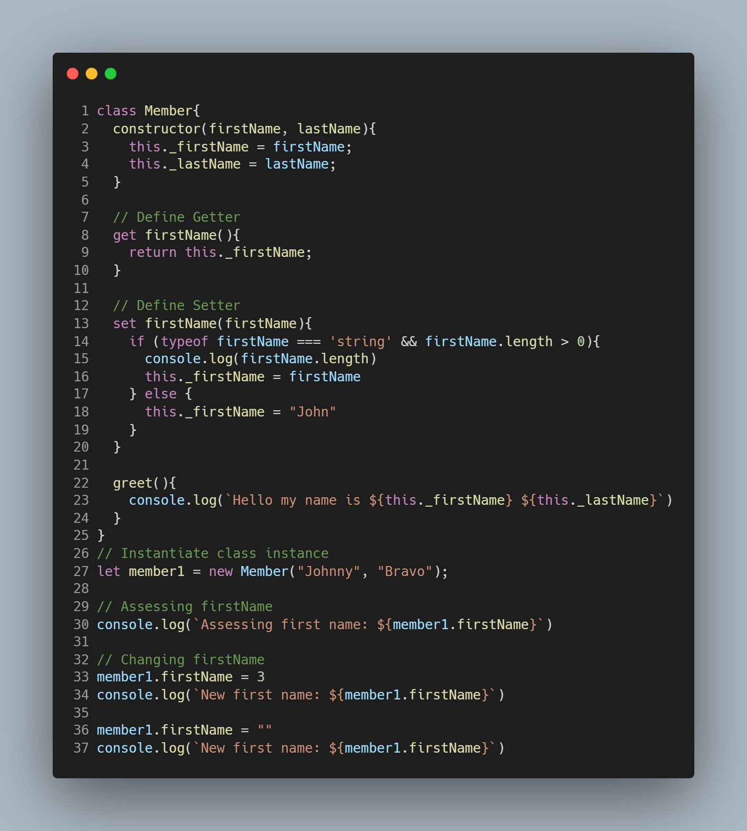

Slide 22
Programming Paradigms - Functional Programming
Core idea of functional programming is simply:
You architect your software out of pure, isolated function
You avoid mutability and side-effects

Slide 23
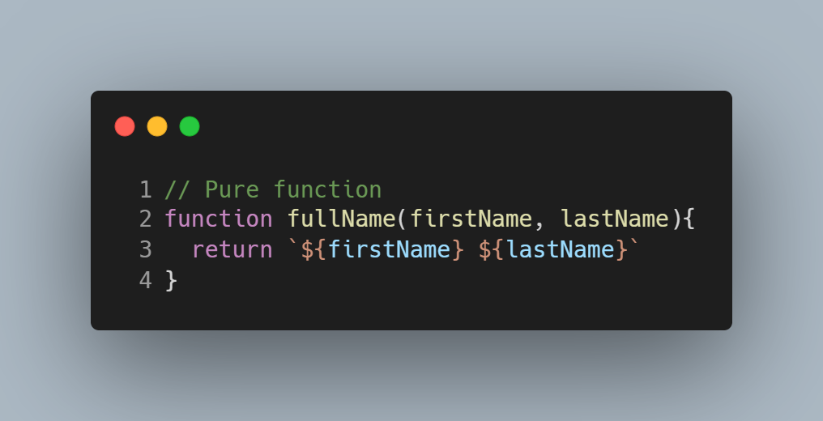

Programming Paradigms - Functional Programming

Slide 24
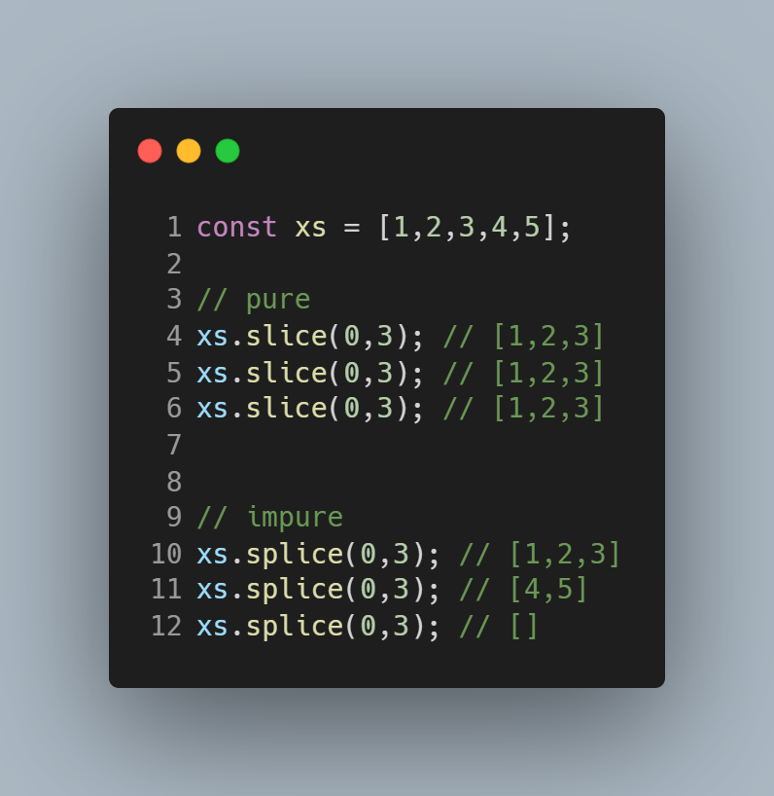
Programming Paradigms - Functional Programming
Credit to Professor Franklin Frisby:-
https://mostly-adequate.gitbook.io/mostly-adequate-guide

Slide 25
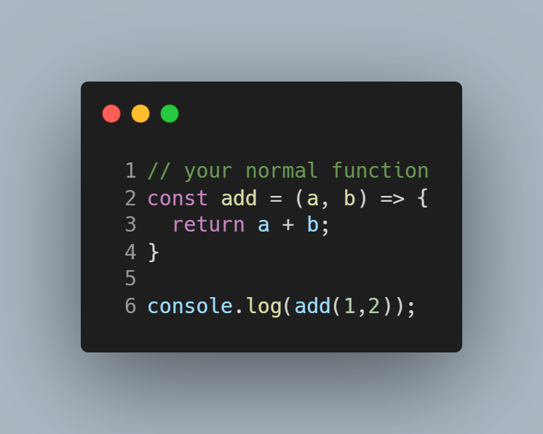
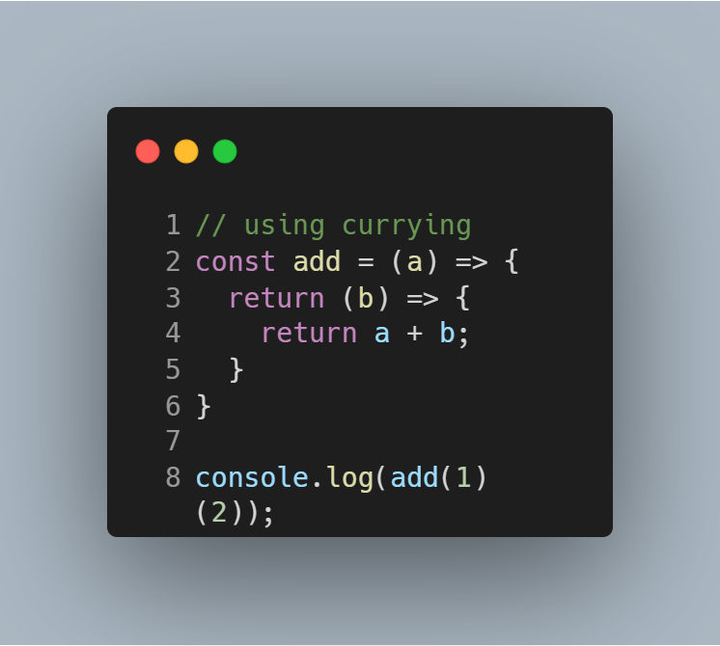
Programming Paradigms - Functional Programming
Credit to Alessio Michelini:-
https://dev.to/darkmavis1980/a-practical-example-on-how-to-use-currying-in-javascript-1ae9

Slide 26
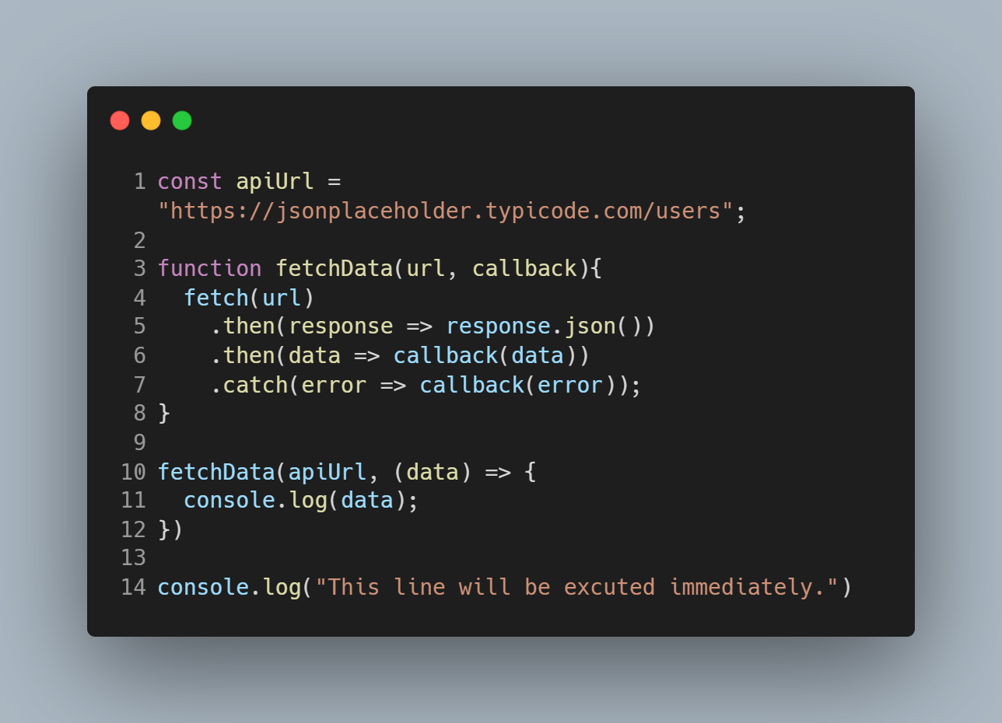

Asynchronous Programming
Asynchronous programming in JavaScript is a paradigm in which operations can be initiated without waiting for their completion.
This allows the program to continue executing other tasks while the asynchronous operation is in progress.
Line 14 will be executed first before printing the data from the API.

Slide 27
Examples of Asynchronous Process
Fetching data from API: When you click a button to load content from a remote server, the browser initiates an asynchronous request. The page doesn't freeze while waiting for the data; other UI elements remain responsive.
Rendering complex graphics: Modern web browsers can render complex graphics asynchronously, allowing the page to remain interactive while the rendering process is underway.
Handling user input: When you type in a search box, the browser might asynchronously suggest search terms based on your input.

Slide 28
Exercise
Scenario:- You are enhancing the team management application module. You need to represent team members more formally, implement different ways to query them, and integrate asynchronous data fetching for additional details.
Objective:- Apply and contrast Object-Oriented, Recursive, Functional, and Asynchronous programming techniques to solve specific problems within the team management context.

Slide 29
Exercise
Define the TeamMember Class
Create a TeamMember class.
The constructor should accept an object containing the raw data (id, firstName, lastName, hobbies, favouriteFoods, pets) and assign these to instance properties.
Implement the following methods within the class:
  fullName(): Returns "LastName, FirstName".
  hasHobby(hobby): Returns true if the member's hobbies array includes the given hobby, false otherwise.
  addPet(petName): Adds a new pet to the member's pets array (demonstrating state mutation).
  getSummary(): Returns a string like "Steve Liam has 2 hobbies and 1 pet(s)."
  Clear pets array using recursive
Notes:
<script>
const rawTeamData = [
{
id: 1,
firstName: "Steve",
lastName: "Liam",
hobbies: ["Reading", "Music"],
favouriteFoods: ["Pizza"],
pets: ["Cat"],
},
{
id: 2,
firstName: "Emily",
lastName: "Rose",
hobbies: ["Painting", "Hiking"],
favouriteFoods: ["Pasta", "Salad"],
pets: ["Dog", "Bird"],
},
{
id: 3,
firstName: "David",
lastName: "Miller",
hobbies: ["Gaming"],
favouriteFoods: ["Burger", "Fries"],
pets: [],
},
{
id: 4,
firstName: "Jessica",
lastName: "Brown",
hobbies: ["Cooking", "Gardening", "Music"],
favouriteFoods: ["Sushi", "Steak"],
pets: ["Rabbit"],
},
{
id: 5,
firstName: "Michael",
lastName: "Davis",
hobbies: ["Photography", "Hiking"],
favouriteFoods: ["Tacos"],
pets: ["Hamster", "Dog"],
},
{
id: 6,
firstName: "Olivia",
lastName: "Wilson",
hobbies: ["Yoga", "Writing", "Music"],
favouriteFoods: ["Soup", "Sandwich"],
pets: ["Fish"],
},
];
console.log("--- Setup Complete ---");
console.log("\n--- The OOP Foundation ---");
class TeamMember {
constructor(data) {
this._id = data.id;
this._firstName = data.firstName;
this._lastName = data.lastName;
this._hobbies = [...data.hobbies];
this._favouriteFoods = [...data.favouriteFoods];
this._pets = [...data.pets];
}
get fullName() {
return `${this._lastName}, ${this._firstName}`;
}
hasHobby(hobby) {
return this._hobbies.includes(hobby);
}
get pets() {
return this._pets;
}
addPet(petName) {
if (!this._pets.includes(petName)) {
this._pets.push(petName);
console.log(
`${this._firstName} ${this._lastName} now has a new pet: ${petName}`
);
} else {
console.log(
`${this._firstName} ${this._lastName} already has a ${petName}.`
);
}
}
get summary() {
const hobbyCount = this._hobbies.length;
const petCount = this.pets.length;
return `${this._firstName} ${this._lastName} has ${hobbyCount} hobbies and ${petCount} pet(s).`;
}
clearPetsRecursive() {
// Base case: If the pets array is empty, stop.
if (this.pets.length === 0) {
console.log(`${this.firstName}'s pets array is now empty.`);
return;
}
// Recursive step: Remove one pet and call the function again.
const removedPet = this.pets.pop(); // Removes the last element
// console.log(`Recursively removed pet: ${removedPet}`); // Optional log
this.clearPetsRecursive(); // Recurse
}
}
// Instantiate Team Members
const teamMemberInstances = rawTeamData.map((data) => new TeamMember(data));
console.log(`Created ${teamMemberInstances.length} TeamMember instances.`);
// Checks
console.log("Member 1 Full Name:", teamMemberInstances[0].fullName);
console.log("Member 2 Summary:", teamMemberInstances[1].summary);
// Add pet
teamMemberInstances[2].addPet("Snake");
console.log("Member 3 Pets after addPet:", teamMemberInstances[2].pets);
</script>

